Slide 1
Reinforced Deep Learning on Carom Billiards
Presented by Mrinal Sourav

Slide 2
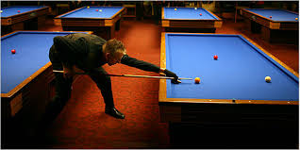
A bit about Carom Billiards

Slide 3
SIMULATION DEMO

Slide 4
The traditional AI
When worlds collide:
I couldn’t do the math! ☹
So, I did the logic ☺
Collision resolution using A-Star
The difference ‘d’ goes as the heuristic to minimize
d

Slide 5
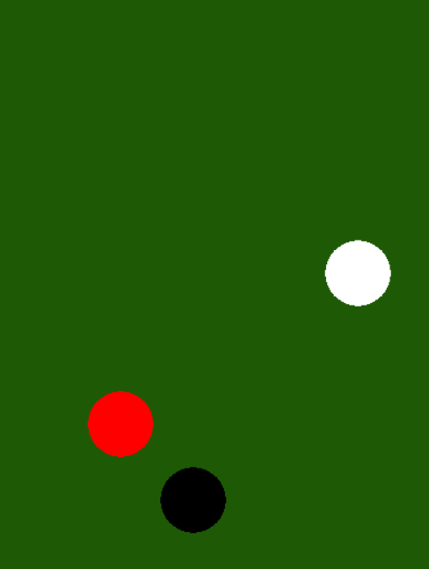
Q-Learning
State: X and Y coordinates of each ball
Future states are not dependent on the current state
Action: Angle and Speed for the q-ball
Q(Quality)-Value: Reward earned from applying the action on the state
0 for no collision
10 for collision with one other ball
100 for collision with both the other balls
Game round starts when all balls are frozen
Game round ends when all balls are frozen

Slide 6
Non Linear Separation
Q-value = 100 X X X X 0 0 0 X X X 0 0
Angles = 1 …. 360

Slide 7
The curse of huge action space
360 angles * 10 speeds = 3600 possible actions
Popular approach to Q-learning:
3600 Possible Actions:
Angle1, Speed1 + q_value
Angle1, Speed2 + q_value
.
.
.
.
Angle360, Speed10 + q_value
q_ball.x
q_ball.y
red_ball.x
red_ball.y
black_ball.x
black_ball.y
Neural Net
Something made me feel this won’t work (CIFAR10 vs CIFAR100)

Slide 8
The curse of huge action space
360 angles * 10 speeds = 3600 possible actions
Approach used:
q_ball.x
q_ball.y
red_ball.x
red_ball.y
black_ball.x
black_ball.y
+
q_ball.angle
q_ball.speed
Neural Net
q_value | action
Training was done online using data generated from “para-simulator”

Slide 9
During Test
q_ball.x
q_ball.y
red_ball.x
red_ball.y
black_ball.x
black_ball.y
+
3600 Possible Actions:
Angle1, Speed1
Angle1, Speed2
.
.
.
.
Angle360, Speed10
q_value1
q_value2
q_value3
.
.
.
.
.
q_value3600
Neural Net
Concatenate and sort to select the action with the highest q_value

Slide 10
Initializing and Training
Started with huge ball size to get an even distribution of rewards
Initialized the network
After multiple trial and errors, the network learnt something

Slide 11
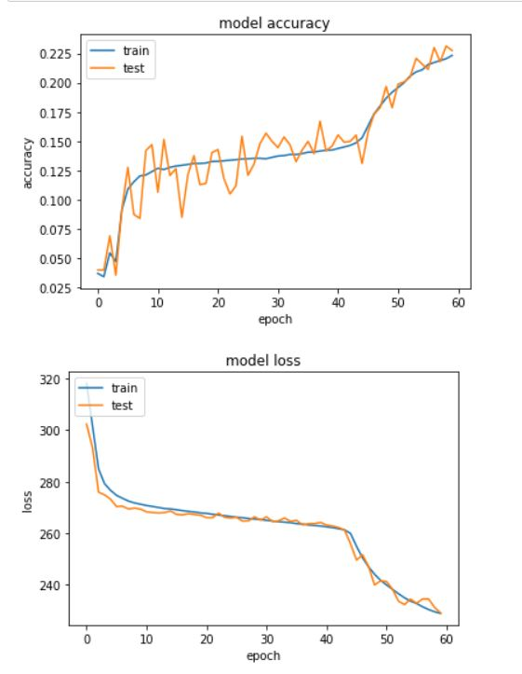
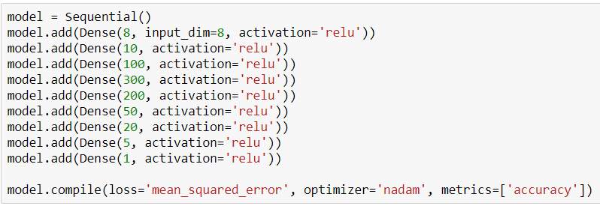
Trained NN Demo
Let’s see what it learned
Comparison with "random_data_generator"
Why is the neural net in such a rush?

Slide 12
The Reinforcement
Given a state, predict the best action
Execute the action and get the “actual-reward”
Train the state+best_action pair on the reward
Further training
Neural Net
State + All Possible Actions
q_value | Best Action
Execute Action
ACTUAL_ REWARD

Slide 13
FIN

